Slide 1
Short Stories

Slide 2
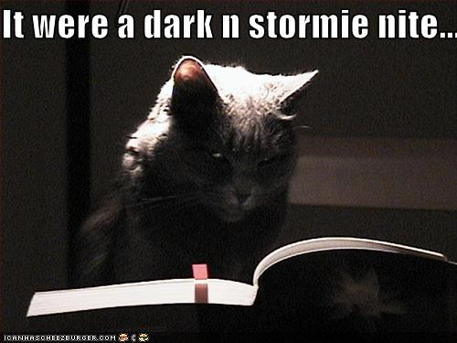
Setting
Time and location which a story takes place

Slide 3
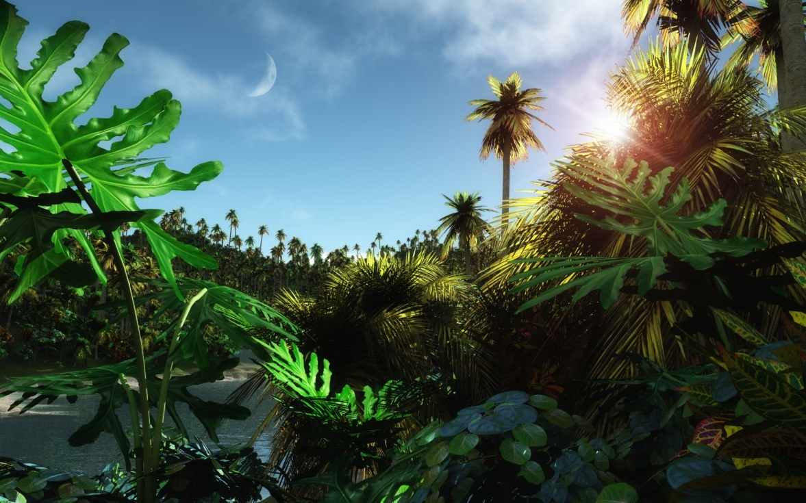
Place - geographical location
Time - When is story taking place? (historical period, time of day, year, etc)
Weather conditions - Rainy, sunny, stormy, etc?

Slide 4
Social conditions - Daily life of the characters like? Does the story contain local colour (writing that focuses on the speech, dress, mannerisms, customs, etc. of a particular place)?
Mood or atmosphere - What feeling is created at beginning of story? Is it bright and cheerful or dark and frightening?

Slide 5
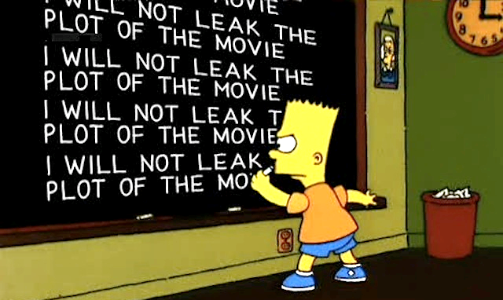
Plot
How author arranges events to develop basic idea
Sequence of events in a story or play
Short stories usually have one plot so it can be read in one sitting

Slide 6
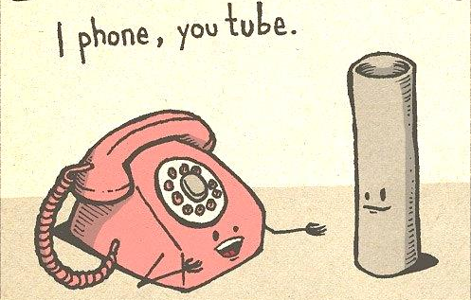
5 Parts of Plot
Introduction - Beginning of the story where the characters and the setting is revealed
Rising Action - Events in story become complicated and conflict in story is revealed (events between the introduction and climax)

Slide 7
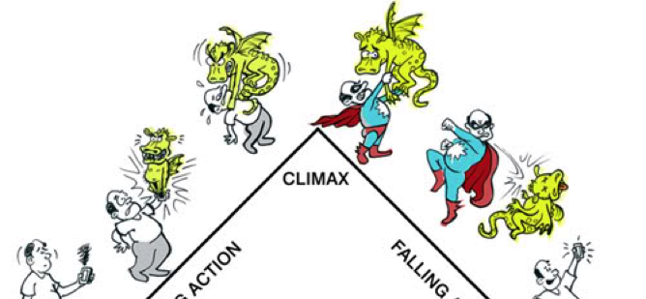
5 Parts of Plot
Climax - Highest point of interest and the turning point of the story. The reader wonders what will happen next; will the conflict be resolved or not?

Slide 8
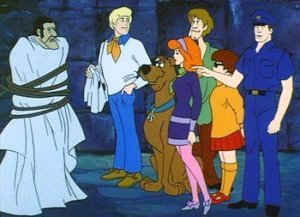
5 Parts of Plot
Falling Action - Events and complications begin to resolve themselves. The reader knows what has happened next and if conflict was resolved or not
Denouement - Final outcome or untangling of events in the story

Slide 9
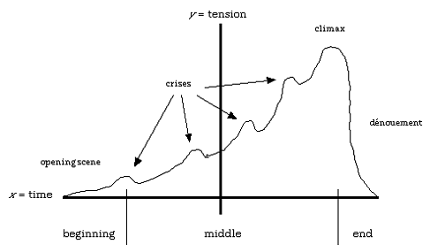

Slide 10
Conflict
Essential to plot
Opposition of forces which ties one incident to another and makes plot move

Slide 11
Conflict
Not merely limited to open arguments
Any form of opposition that faces the main character

Slide 12
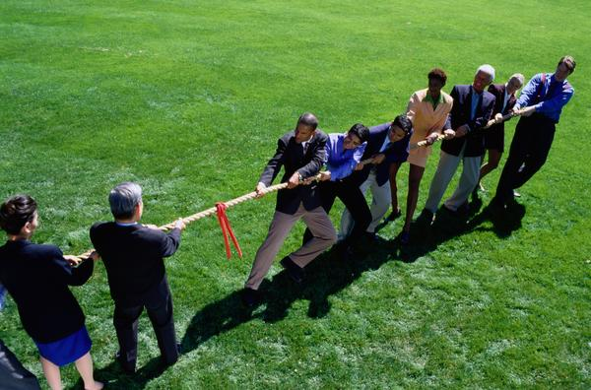
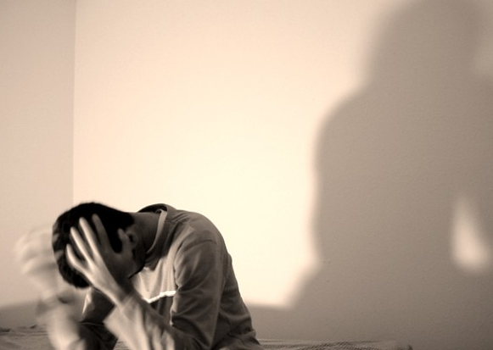
Types on Conflict
External - Struggle with force outside one's self
Internal - Struggle within one's self; person must make some decision, overcome pain, quiet their temper, resist an urge, etc.

Slide 13
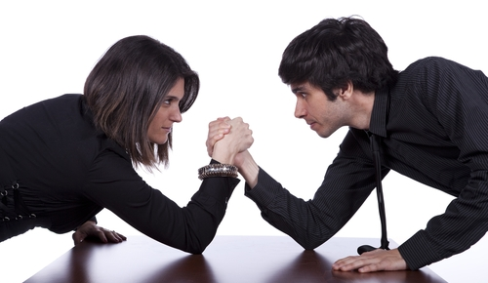
Kinds of Conflict
1) Person vs. Person (physical) – Character struggles with physical strength against other person or animal
2) Person vs. Environment (nature) - Character struggles against nature in a battle for survival

Slide 14
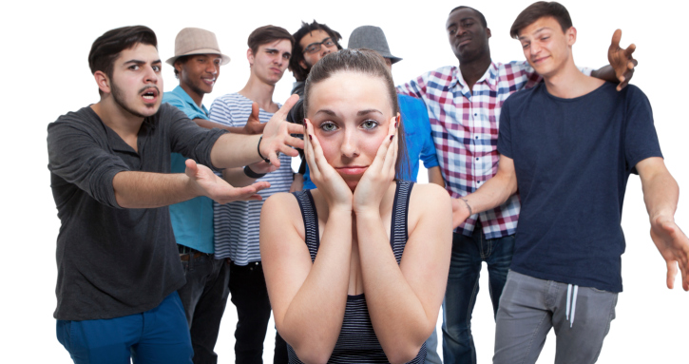
Kinds of Conflict
3) Person vs. Society (social) - Character struggles against ideas, practices, or customs of other people
4) Person vs. Self (psychological) - Character struggles with themselves; with their own soul, ideas of right or wrong, physical limitations, choices, etc.

Slide 15
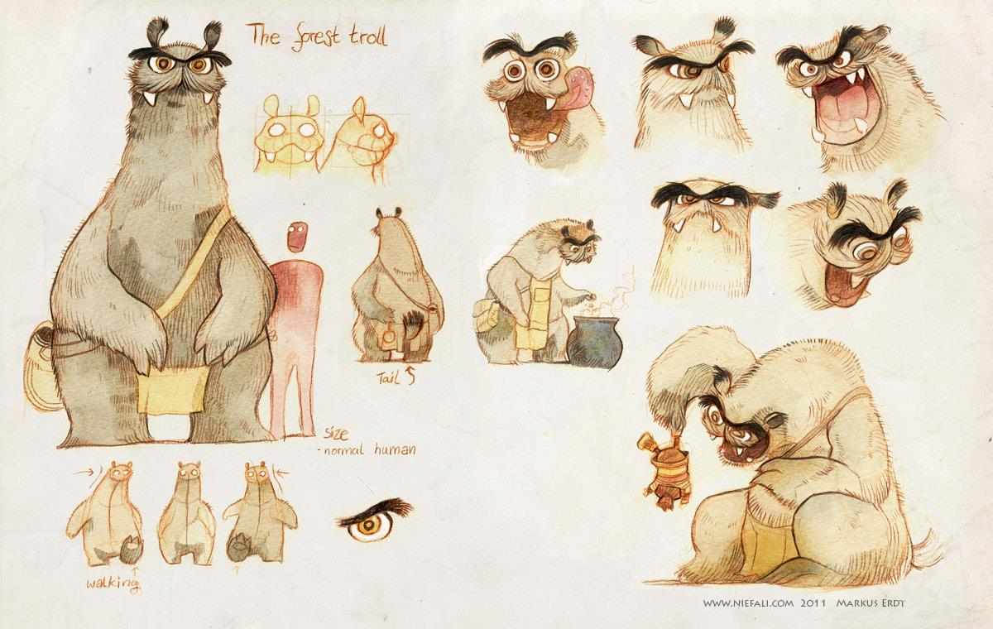
Character
1) Person in a work of fiction 2) Characteristics of a person

Slide 16
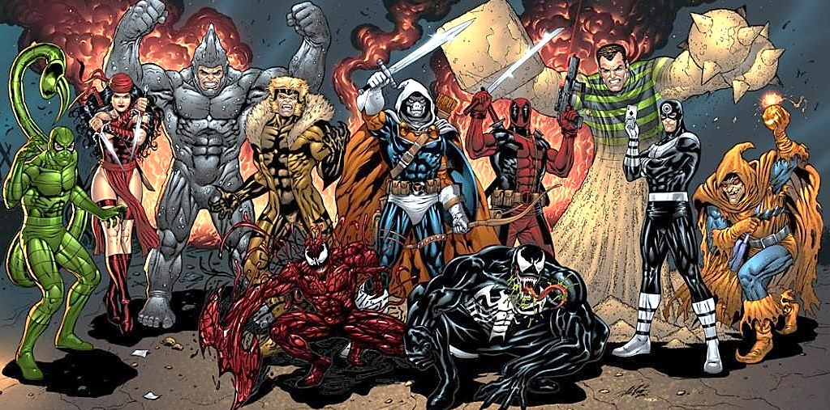
Persons in a Work of Fiction
PROTAGONIST
Clearly central to story with all major events having some importance to them
ANTAGONIST
Opposer of main character

Slide 17
Characters Are…
Dynamic - Many sided personalities that change, for better or worse, by the end of the story
Static - Stereotype, have one or two characteristics that never change and are emphasized
Ex: brilliant detective, drunk, scrooge, cruel stepmother, etc

Slide 18
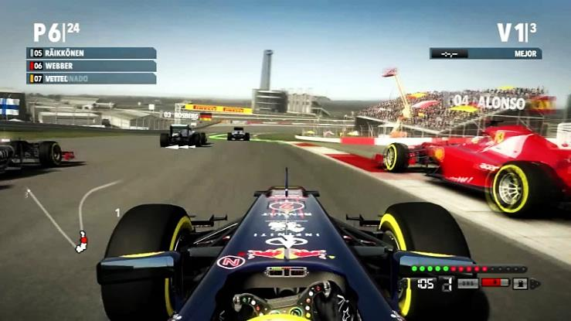
Point of View - First Person
When a character narrates their story with their thoughts and emotions
“I” “my” “we” “our”
Ex: Sad that my girlfriend had left me, I wasn’t paying attention as I walked down the street. A man drove by and yelled, “Hey, watch where you’re going!”

Slide 19
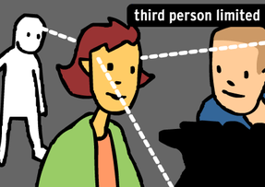
Point of View - Third-person LIMITED
Narrator tells one character’s story
and reveals that character’s thoughts
or feelings
Ex: Sad that his girlfriend had left him, Ben wasn’t paying attention as he walked down the middle of the street.
A man drove by and yelled, “Hey, watch where you’re going!”

Slide 20
Point of View - Third-person OMNISCIENT
Narrator tells a story and reveals more than one character’s thoughts or feelings
Ex: Sad that his girlfriend had left him, Ben wasn’t paying attention as he walked down the middle of the street.
Tom was also having a bad day, as he was late for work. As he was driving, he almost hit Ben who was walking in the middle of the street. “Hey, watch where you’re going!” Tom angrily yelled out his car window.

